Slide 1

Course – TFC
Course Instructor
Dr. Umadevi V
Department of CSE, BMSCE
Webpage:https://sites.google.com/site/drvumadevi/

Slide 2
Unit-5
Problems That Computers Cannot Solve
The Turing Machine, Programming Techniques for Turing Machines, Extensions to the Basic Turing Machine, Restricted Turing Machines, Turing Machines and Computers, Definition of Post’s Correspondence Problem, A Language That Is Not Recursively Enumerable, An Undecidable Problem That is RE
Other Undecidable Problems

Slide 3
Problems That Computers Cannot Solve
Specific Problems we cannot solve using a computer are called “Undecidable”

Slide 4

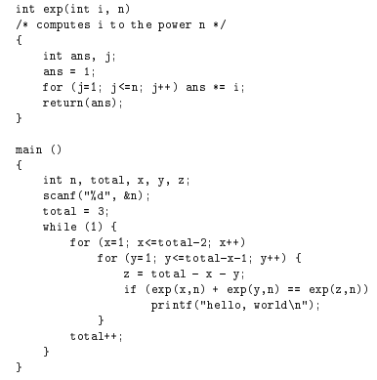
Example
Program to print “Hello World” | Fermat’s last theorem expressed as a hello world program
Hello World Problem: Determine
whether a given C program, with
given input, prints “Hello World”
Note: In number theory, Fermat's Last Theorem states that no three positive integers a, b, and c satisfy the equation a^{n} + b^{n} = c^{n} for any integer value of n greater than 2.

Slide 5
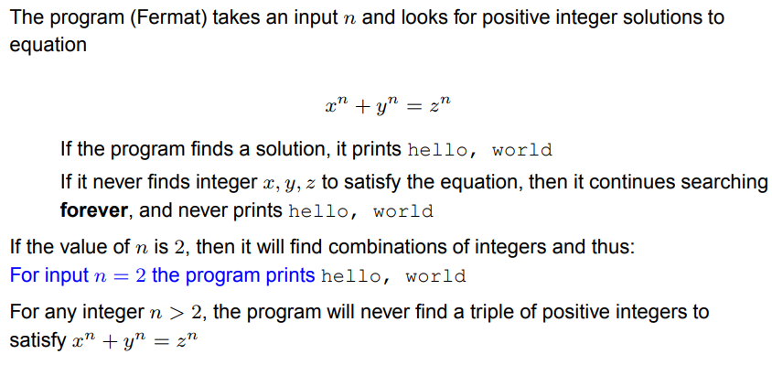
Example

Slide 6
Our hello-world problem
Is there a program H that could examine any program P and any input I for P, and tell whether P, run with I as its input, would print hello, world?
The answer is: undecidable!
That is, there exists no such program H.
We can prove this by contradiction next.

Slide 7
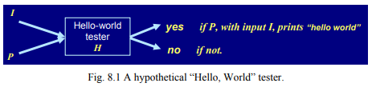
Hypothetical “Hello, World” Tester
We want to prove that no program H, called hypothetical “Hello, World” tester, as mentioned previously exists by contradiction using the following steps.
Step 1: assume H exists in a form as shown in Fig. 8.1
Step 2: Transform H into another form H2 in a simple way which can be done by C programs.
Step 3: prove that H2 does not exist and so that H does not exist, either

Slide 8
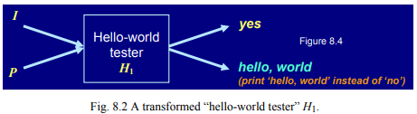
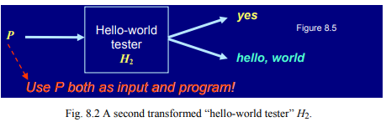
Hypothetical “Hello, World” Tester (Contd…)
Implementation of Step 2 in previous slide
(1) Transform H to H1 in a way as illustrated by Fig. 8.2
(2) Transform H1 to H2 in a way as illustrated by Fig. 8.3
The function of H2 constructed in Step 2 is given any program P as input,
if P prints hello, world as first output, then H2 makes output yes;
if P does not prints hello, world as first output, then H2 prints hello, world

Slide 9
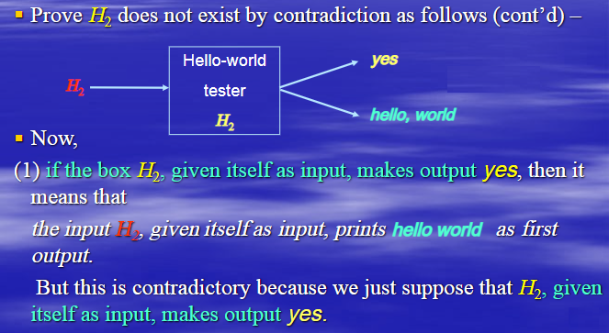
Hypothetical “Hello, World” Tester (Contd…)
Implementation of Step 3 above (proving H2 does not exist) ---

Slide 10
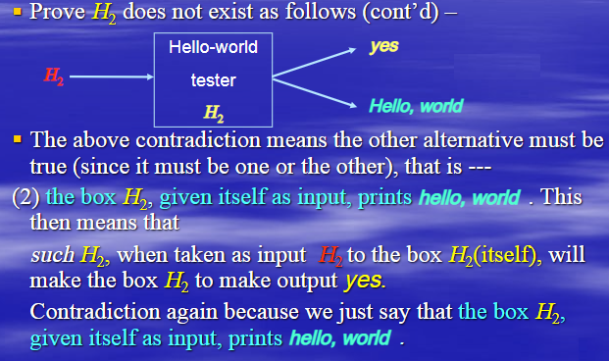
Hypothetical “Hello, World” Tester (Contd…)
Implementation of Step 3 above (proving H2 does not exist) ---

Slide 11
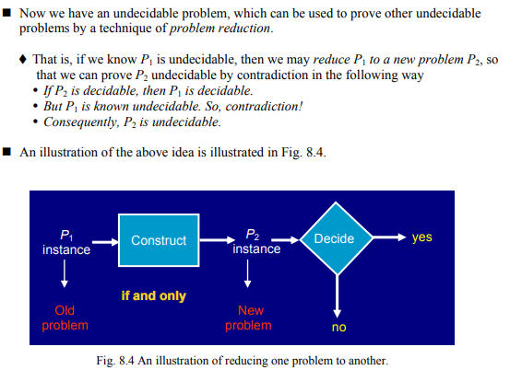
Reducing One Problem to Another

Slide 12
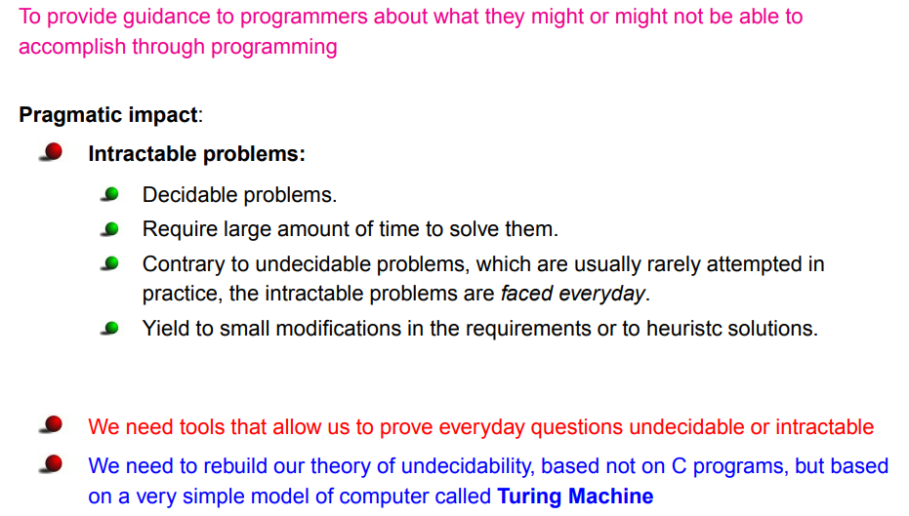
Propose of the theory of undecidable problems

Slide 13
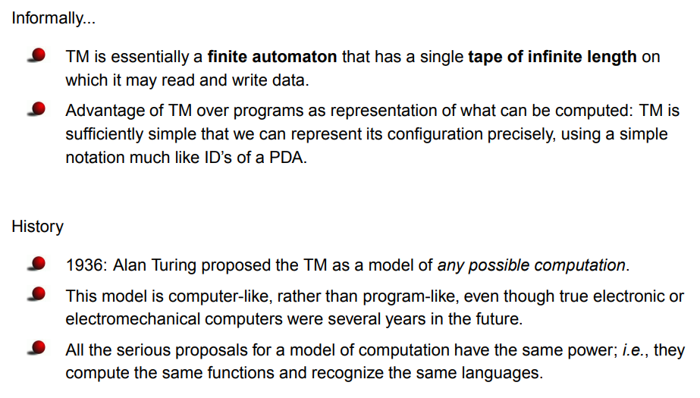
The Turing Machine ™

Slide 14
Turing Machine (TM)

Slide 15
Turing machine model
Input Tape
a₀ | a₁ | a₂ | …… | a_{n-1} | a_{n} | B | B | …..
Read-Write head
Control
Unit

Slide 16
Formal Definition of Turning Machine
P=(Q, ∑ , Γ , δ , q₀, B, F)
Q is set of states
∑ is set of input alphabet
Γ is set of tape symbols
q₀ ∈ Q , is the start state
B is special symbol indicating blank character
F is the set of final states
δ is a transition function which maps QxΓ to QxΓ x{L, R}
Note: L and R indicate Left or Right direction move

Slide 17
Question
Design Turing Machine for L= {0^{n}1^{n}, n>=1}
Example:
Valid String: 000111
Invalid String:00111
Input
tape
0 | 0 | 0 | 1 | 1 | 1 | B

Slide 18
Question
Design Turing Machine for L= {0^{n}1^{n}, n>=1}
Example:
Valid String: 000111
Invalid String:00111
Approach used – First replace a 0 from front by X, then keep moving right till you find a 1 and replace this 1 by Y.
Now keep moving left till you find a X. When you find it, move a right, then
follow the same procedure as above.
A condition comes when you find a X immediately followed by a Y. At this point we keep moving right and keep on checking that all 1’s have been converted to Y. If not then string is not accepted. If we reach B then string is accepted.
Input
tape
0 | 0 | 0 | 1 | 1 | 1 | B

Slide 19
Rough Slide to Explain “Designing Turing Machine for L= {0^{n}1^{n}, n>=1}”
Approach used – First replace a 0 from front by X, then keep moving right till you find a 1 and replace this 1 by Y.
Now keep moving left till you find a X. When you find it, move a right, then follow the same procedure as above.
A condition comes when you find a X immediately followed by a Y. At this point we keep moving right and keep on checking that all 1’s have been converted to Y. If not then string is not accepted. If we reach B then string is accepted.
0 | 0 | 0 | 1 | 1 | 1 | B
0 | 0 | 0 | 1 | 1 | 1 | B
0 | 0 | 0 | 1 | 1 | 1 | B

Slide 20
Rough Slide to Explain “Designing Turing Machine for L= {0^{n}1^{n}, n>=1}”
Approach used – First replace a 0 from front by X, then keep moving right till you find a 1 and replace this 1 by Y.
Now keep moving left till you find a X. When you find it, move a right, then follow the same procedure as above.
A condition comes when you find a X immediately followed by a Y. At this point we keep moving right and keep on checking that all 1’s have been converted to Y. If not then string is not accepted. If we reach B then string is accepted.
X | 0 | 0 | Y | 1 | 1 | B
X | 0 | 0 | Y | 1 | 1 | B
X | 0 | 0 | Y | 1 | 1 | B

Slide 21
Rough Slide to Explain “Design Turing Machine for L= {0^{n}1^{n}, n>=1}”
Approach used – First replace a 0 from front by X, then keep moving right till you find a 1 and replace this 1 by Y.
Now keep moving left till you find a X. When you find it, move a right, then follow the same procedure as above.
A condition comes when you find a X immediately followed by a Y. At this point we keep moving right and keep on checking that all 1’s have been converted to Y. If not then string is not accepted. If we reach B then string is accepted.
X | X | 0 | Y | Y | 1 | B
X | X | 0 | Y | Y | 1 | B
X | X | 0 | Y | Y | 1 | B

Slide 22
Rough Slide to Explain “Designing Turing Machine for L= {0^{n}1^{n}, n>=1}”
Approach used – First replace a 0 from front by X, then keep moving right till you find a 1 and replace this 1 by Y.
Now keep moving left till you find a X. When you find it, move a right, then follow the same procedure as above.
A condition comes when you find a X immediately followed by a Y. At this point we keep moving right and keep on checking that all 1’s have been converted to Y. If not then string is not accepted. If we reach B then string is accepted.
X | X | X | Y | Y | Y | B

Slide 23
Rough Slide to Explain “Designing Turing Machine for L= {0^{n}1^{n}, n>=1}”
Approach used – First replace a 0 from front by X, then keep moving right till you find a 1 and replace this 1 by Y.
Now keep moving left till you find a X. When you find it, move a right, then follow the same procedure as above.
A condition comes when you find a X immediately followed by a Y. At this point we keep moving right and keep on checking that all 1’s have been converted to Y. If not then string is not accepted. If we reach B then string is accepted.
0 | 0 | 1 | 1 | 1 | B
Invalid String

Slide 24
Rough Slide to Explain “Designing Turing Machine for L= {0^{n}1^{n}, n>=1}”
Approach used – First replace a 0 from front by X, then keep moving right till you find a 1 and replace this 1 by Y.
Now keep moving left till you find a X. When you find it, move a right, then follow the same procedure as above.
A condition comes when you find a X immediately followed by a Y. At this point we keep moving right and keep on checking that all 1’s have been converted to Y. If not then string is not accepted. If we reach B then string is accepted.
X | 0 | Y | 1 | 1 | B
Invalid String

Slide 25
Rough to Explain “Designing Turing Machine for L= {0^{n}1^{n}, n>=1}”
Approach used – First replace a 0 from front by X, then keep moving right till you find a 1 and replace this 1 by Y.
Now keep moving left till you find a X. When you find it, move a right, then follow the same procedure as above.
A condition comes when you find a X immediately followed by a Y. At this point we keep moving right and keep on checking that all 1’s have been converted to Y. If not then string is not accepted. If we reach B then string is accepted.
X | X | Y | Y | 1 | B
Invalid String

Slide 26
Design Turing Machine for L= {0^{n}1^{n}, n>=1}
Logic
0 | 0 | 0 | 1 | 1 | 1 | B
Step-1: Replace 0 by X and move right,
Go to state q1.
q₀
_{(0, X, R)}
q₁

Slide 27
Design Turing Machine for L= {0^{n}1^{n}, n>=1}
Logic
0 | 0 | 0 | 1 | 1 | 1 | B
Step-1: Replace 0 by X and move right,
Go to state q1.
q₀
_{(0, X, R)}
q₁
X | 0 | 0 | Y | 1 | 1 | B
Step-2: Replace 0 by 0 and move right,
Remain on same state. Replace Y by Y and move right, Remain on same state. Replace 1 by Y and move left, go to state q2.
_{(0, 0, R)}
_{(Y, Y, R)}
q₀
_{(0, X, R)}
q₁
_{(1, Y, L)}
q₂

Slide 28
Design Turing Machine for L= {0^{n}1^{n}, n>=1}
Logic
Step-3:
Replace 0 by 0 and move left, Remain on same state
Replace Y by Y and move left, Remain on same state
Replace X by X and move right, go to state q0.
X | 0 | 0 | Y | 1 | 1 | B
_{(0, 0, R)}
_{(Y, Y, R)}
_{(Y, Y, L)}
_{(0, 0, L)}
q₀
_{(0, X, R)}
q₁
_{(1, Y, L)}
q₂
_{(X, X, R)}

Slide 29
Design Turing Machine for L= {0^{n}1^{n}, n>=1}
Logic
Step-4: If symbol is Y replace it by Y and move right and Go to state q3 Else go to step 1
X | 0 | 0 | Y | 1 | 1 | B
_{(0, 0, R)}
_{(Y, Y, R)}
_{(Y, Y, L)}
_{(0, 0, L)}
q₀
_{(0, X, R)}
q₁
_{(1, Y, L)}
q₂
_{(X, X, R)}
_{(Y, Y, R)}
q₃
_{(Y, Y, R)}

Slide 30
Design Turing Machine for L= {0^{n}1^{n}, n>=1}
Step-5: Replace Y by Y and move right, remain on same state If symbol is B replace it by B and move right STRING IS ACCEPTED, GO TO FINAL STATE q4
Logic
X | X | X | Y | Y | Y | B
_{(0, 0, R)}
_{(Y, Y, R)}
_{(Y, Y, L)}
_{(0, 0, L)}
q₀
_{(0, X, R)}
q₁
_{(1, Y, L)}
q₂
_{(X, X, R)}
_{(Y, Y, R)}
q₃
_{(Y, Y, R)}
q₄
_{(B, B, R)}

Slide 31
Design Turing Machine for L= {0^{n}1^{n}, n>=1}
Transition diagram
_{(0, 0, R)}
_{(Y, Y, R)}
_{(Y, Y, L)}
_{(0, 0, L)}
q₀
_{(0, X, R)}
q₁
_{(1, Y, L)}
q₂
_{(X, X, R)}
_{(Y, Y, R)}
q₃
_{(Y, Y, R)}
q₄
_{(B, B, R)}

Slide 32
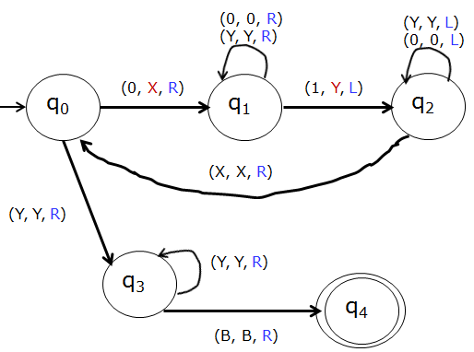
Design Turing Machine for L= {0^{n}1^{n}, n>=1}
Formal Definition
M=(Q, ∑ , Γ , δ , q₀, B, F)
Q = {q₀, q₁, q₂, q₃, q₄}
∑ = {0, 1}
Γ = {0, 1, X, Y, B}
q₀ = q₀
B = B
F = {q₄}
Transition Diagram
δ Transition table
State | Input tape Symbols
 | 0 | 1 | X | Y | B
q₀ | (q₁, X , R) | --- | --- | (q₃, Y , R) | --
q₁ | (q₁, 0 , R) | (q₂, Y, L) | --- | (q₁, Y , R) | ---
q₂ | (q₂, 0 , L) | --- | (q₀, X,R) | (q₂, Y,L) | ---
q₃ | --- | --- | --- | (q₃, Y , R) | (q₄,B,R)
q₄ | --- | --- | --- | --- | ---

Slide 33
TM for L= {0^{n}1^{n}, n>=1} (Contd….) Rough Slide
Instantaneous description for the string 0011
q₀0011B

Slide 34
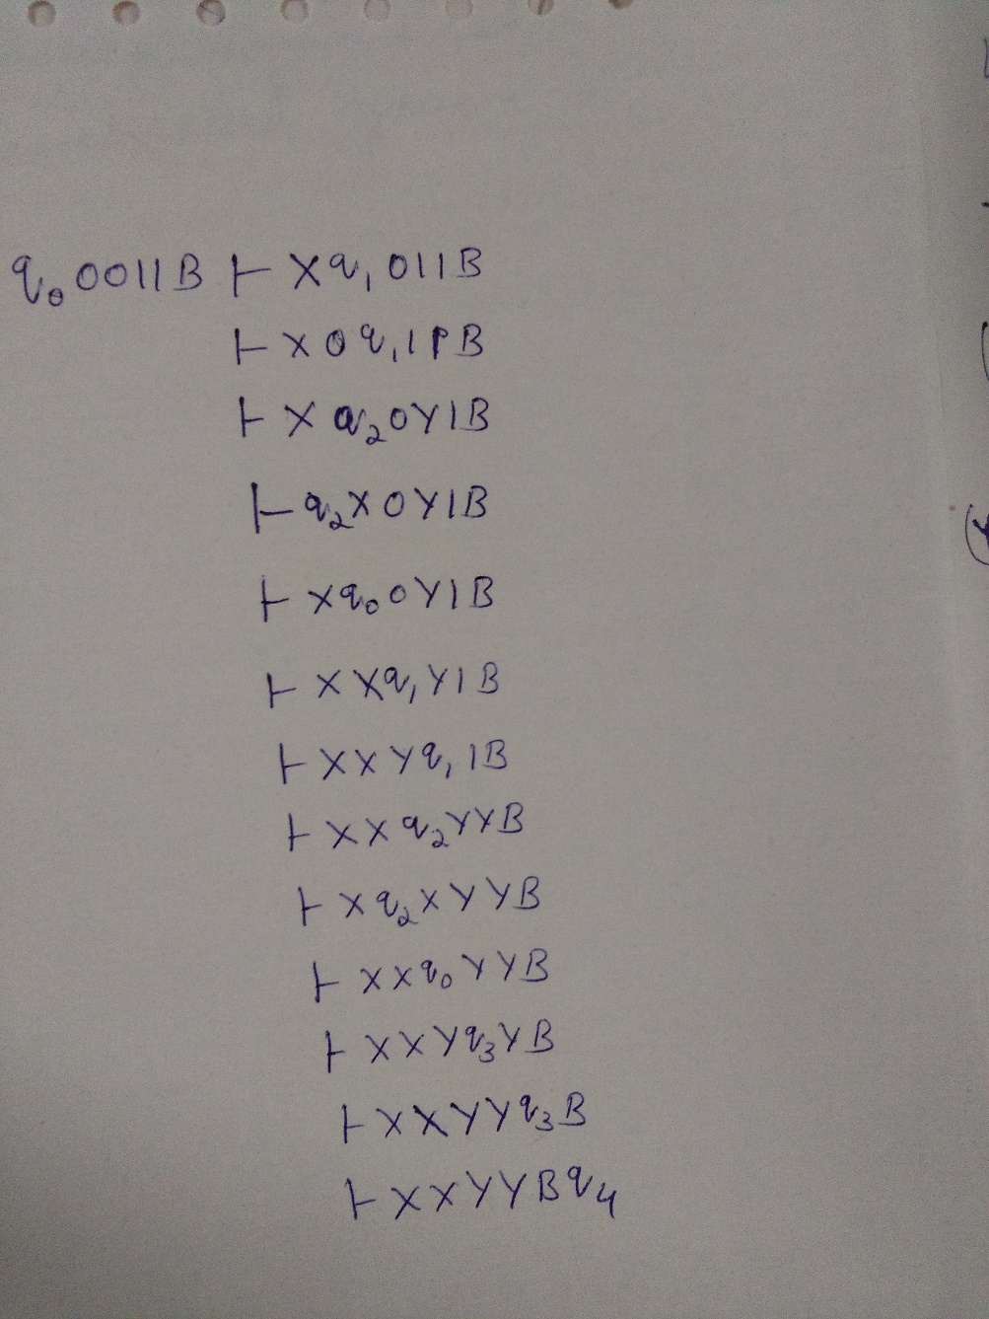
TM for L= {0^{n}1^{n}, n>=1} (Contd….)
Instantaneous description for the string 0011

Slide 35
Question
Design Turing Machine for L= {0^{n}1^{n}2^{n}, n>=1}
Example:
Valid String: 000111222
Invalid String:00111222
Assumption: We will replace 0 by X, 1 by Y and 2 by Z Approach used – - First replace a 0 from front by X, then keep moving right till you find a 1 and replace this 1 by Y. Again, keep moving right till you find a 2, replace it by Z and move left. Now keep moving left till you find a X. When you find it, move a right, then follow the same procedure as above.
- A condition comes when you find a X immediately followed by a Y. At this point we keep moving right and keep on checking that all 1’s and 2’s have been converted to Y and Z. If not then string is not accepted. If we reach B and final state then string is accepted.
Input
tape
0 | 0 | 0 | 1 | 1 | 1 | 2 | 2 | 2 | B

Slide 36
Design Turing Machine for L= {0^{n}1^{n}2^{n}, n>=1}
Logic
0 | 0 | 1 | 1 | 2 | 2 | B
Step-1: Replace 0 by X and move right,
Go to state q1.
q₀
_{(0, X, R)}
q₁
X | 0 | Y | 1 | 2 | 2 | B
Step-2: Replace 0 by 0 and move right, Remain on same state Replace Y by Y and move right, Remain on same state Replace 1 by Y and move right, go to state q2.
_{(0, 0, R)}
_{(Y, Y, R)}
q₀
_{(0, X, R)}
q₁
_{(1, Y, R)}
q₂

Slide 37
Design Turing Machine for L= {0^{n}1^{n}2^{n}, n>=1}
Logic
Step-3: Replace 1 by 1 and move right, Remain on same state Replace Z by Z and move right, Remain on same state Replace 2 by Z and move left, go to state q3.
X | 0 | Y | 1 | 2 | 2 | B
_{(0, 0, R)}
_{(Y, Y, R)}
_{(Z, Z, R)}
_{(1, 1, R)}
q₀
_{(0, X, R)}
q₁
_{(1, Y, R)}
q₂
_{(2, Z, L)}
q3

Slide 38
Design Turing Machine for L= {0^{n}1^{n}2^{n}, n>=1}
Logic
Step-4: Replace Z by Z and move left, Remain on same state Replace 1 by 1 and move left, Remain on same state Replace Y by Y and move left, Remain on same state Replace 0 by 0 and move left, Remain on same state Replace X by X and move right, go to state q0.
X | 0 | Y | 1 | Z | 2 | B
_{(Z, Z, L)}
_{(1, 1, L)}
_{(Y, Y, L)}
_{(0, 0, L)}
_{(0, 0, R)}
_{(Y, Y, R)}
_{(Z, Z, R)}
_{(1, 1, R)}
q₀
_{(0, X, R)}
q₁
_{(1, Y, R)}
q₂
_{(2, Z, L)}
q3
_{(X, X, R)}

Slide 39
Design Turing Machine for L= {0^{n}1^{n}2^{n}, n>=1}
Logic
Step-5: If symbol is Y replace it by Y and move right and Go to state q4 Else go to Step-1
X | X | Y | Y | Z | Z | B
_{(Z, Z, L)}
_{(1, 1, L)}
_{(Y, Y, L)}
_{(0, 0, L)}
_{(0, 0, R)}
_{(Y, Y, R)}
_{(Z, Z, R)}
_{(1, 1, R)}
q₀
_{(0, X, R)}
q₁
_{(1, Y, R)}
q₂
_{(2, Z, L)}
q3
_{(X, X, R)}
_{(Y, Y, R)}
q4

Slide 40
Design Turing Machine for L= {0^{n}1^{n}2^{n}, n>=1}
Logic
Step-6: Replace Y by Y and move right, Remain on same state
If the symbol is Z, replace it by Z and move right and go to the state q5
Step-7:
Replace Z by Z and move right, Remain on same state If symbol is B replace it by B and move right, STRING IS ACCEPTED, GO TO FINAL STATE q6
X | X | Y | Y | Z | Z | B
_{(Z, Z, L)}
_{(1, 1, L)}
_{(Y, Y, L)}
_{(0, 0, L)}
_{(0, 0, R)}
_{(Y, Y, R)}
_{(Z, Z, R)}
_{(1, 1, R)}
q₀
_{(0, X, R)}
q₁
_{(1, Y, R)}
q₂
_{(2, Z, L)}
q3
_{(X, X, R)}
_{(Y, Y, R)}
_{(Y, Y, R)}
_{(Z, Z, R)}
q4
q4
q₅
q6
_{(Z, Z, R)}
_{(B, B, R)}

Slide 41
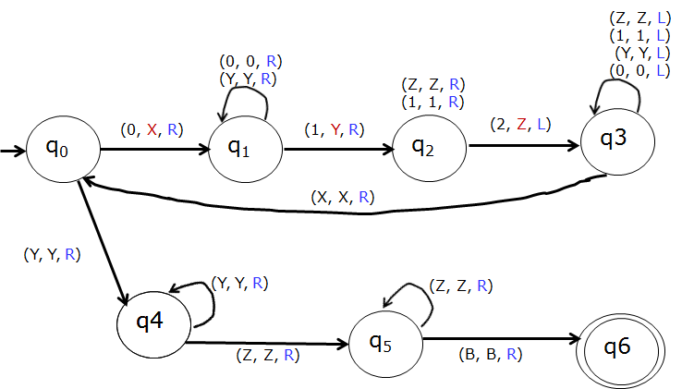
Complete design of Turing Machine for L= {0^{n}1^{n}2^{n}, n>=1}
Formal Definition
M=(Q, ∑ , Γ , δ , q₀, B, F)
Q = {q₀, q₁, q₂, q₃, q_{4,} q_{5 ,} q₆}
∑ = {0, 1,2}
Γ = {0, 1, 2, X, Y, Z, B}
q₀ = q₀
B = B
F = {q₆}
Transition
Diagram
δ Transition table
State | Input tape Symbols
 | 0 | 1 | 2 | X | Y | Z | B
q₀ | (q₁, X , R) | --- |  | --- | (q4, Y , R) | -- | --
q₁ | (q₁, 0 , R) | (q₂, Y, R) |  | --- | (q₁, Y , R) | --- | ---
q₂ | --- | (q₂, 1, R) | (q₃, Z, L) | --- | --- | (q₂, Z,R) | ---
q₃ | (q₃, 0 , L) | (q₃, 1, L) | -- | (q₀,X,R) | (q₃, Y,L) | (q₃, Z,L) | ---
q₄ | --- | --- | --- | --- | (q₄, Y , R) | (q₅, Z , R) | ---
q₅ | --- | --- | --- | --- | --- | (q₅, Z , R) | (q₆,B,R)
q₆ | --- | --- | --- | --- | --- | --- | ---

Slide 42
Question
Design TM for L={wcw^{r}, w ∈ (0+1)*}
Valid string: 110c011
1 | 1 | 0 | c | 0 | 1 | 1 | B

Slide 43
TM for L={wcw^{r}, w ∈ (0+1)*}
_{(c, c, L)}
_{(1, 1, L)}
_{(0, 0, L)}
_{(c, c, R)}
_{(1, 1, R)}
_{(0, 0, R)}
_{(B, B, L)}
_{(X, X, L)}
_{(Y, Y, L)}
q₀
_{(0, X, R)}
q₁
q₂
_{(0, X, L)}
q3
_{(X, X, R)}
_{(Y, Y, R)}

Slide 44
TM for L={wcw^{r}, w ∈ (0+1)*}
_{(c, c, L)}
_{(1, 1, L)}
_{(0, 0, L)}
_{(c, c, R)}
_{(1, 1, R)}
_{(0, 0, R)}
_{(B, B, L)}
_{(X, X, L)}
_{(Y, Y, L)}
q₀
_{(0, X, R)}
q₁
q₂
_{(0, X, L)}
q3
_{(X, X, R)}
_{(Y, Y, R)}
_{(1, Y, R)}
_{(1, Y, L)}
_{(c, c, R)}
_{(1, 1, R)}
_{(0, 0, R)}
q₄
_{(X, X, L)}
_{(Y, Y, L)}
_{(B, B, L)}
q₅

Slide 45
Complete TM for L={wcw^{r}, w ∈ (0+1)*}
_{(c, c, L)}
_{(1, 1, L)}
_{(0, 0, L)}
_{(c, c, R)}
_{(1, 1, R)}
_{(0, 0, R)}
_{(B, B, L)}
_{(X, X, L)}
_{(Y, Y, L)}
q₀
_{(0, X, R)}
q₁
q₂
_{(0, X, L)}
q3
_{(X, X, R)}
_{(Y, Y, R)}
_{(c, c, R)}
_{(1, Y, R)}
_{(1, Y, L)}
_{(c, c, R)}
_{(1, 1, R)}
_{(0, 0, R)}
_{(x, X, R)}
_{(Y, Y, R)}
q₆
q₅
q₇
q₄
_{(X, X, L)}
_{(Y, Y, L)}
_{(B, B, L)}
_{(B, B, R)}

Slide 46
Question
Design TM which accepts the set of all palindromes over {0, 1}
Example:
Valid Strings:
010
0110
Invalid Strings:
1010
110

Slide 47
Complete design of TM which accepts the set of all palindromes over {0, 1}
_{(1, 1, R)}
_{(0, 0, R)}
_{(B, B, L)}
_{(X, X, L)}
_{(Y, Y, L)}
q₁
q₂
_{(0, X, L)}
_{(1, 1, L)}
_{(0, 0, L)}
_{(X, X, R)}
_{(Y, Y, R)}
_{(0, X, R)}
q3
_{(X, X, R)}
_{(Y, Y, R)}
q₀
q₆
_{(1, Y, R)}
_{(1, 1, R)}
_{(0, 0, R)}
_{(X, X, R)}
_{(Y, Y, R)}
_{(1, Y, L)}
_{(X, X, L)}
_{(Y, Y, L)}
_{(B, B, L)}
q₄
q₅
_{(X, X, R)}
_{(Y, Y, R)}

Slide 48
Question
Design Turing Machine to compute the function, which is called monus or proper subtraction and is defined by
(m-n) = max (m-n, 0)
Note:
The monus operation is defined as
(m-n) = (m-n) if m ≥ n
(m-n) = 0 if m < n
Example:
If m = 5 , n =2 then (m-n) = (5-2) = 3
If m = 2 , n =5 then (m-n) = (2-5) = 0

Slide 49
Design TM to compute the function, which is called monus or proper subtraction and is defined by (m-n) = max (m-n, 0)
To start with the tape consists of 0^{m}10^{n} which is terminated by blank symbol.
Example:
m=5 , n=2
Input tape
Output Tape
m=2 , n=5
Input tape
Output Tape
0 | 0 | 0 | 0 | 0 | 1 | 0 | 0 | B
B | B | 0 | 0 | 0 | B | B | B | B
(5-2)=3
0 | 0 | 1 | 0 | 0 | 0 | 0 | 0 | B
B | B | B | B | B | B | B | B | B
(2-5)=0

Slide 50
Design TM to compute the function, which is called monus or proper subtraction and is defined by (m-n) = max (m-n, 0) Rough Slide
To start with the tape consists of 0^{m}10^{n} which is terminated by blank symbol.
Example:
m=2 , n=5
Input tape
Output Tape
0 | 0 | 1 | 0 | 0 | 0 | 0 | 0 | B
B | B | B | B | B | B | B | B | B
(2-5)=0

Slide 51
Design TM to compute the function, which is called monus or proper subtraction and is defined by (m-n) = max (m-n, 0) Rough Slide
To start with the tape consists of 0^{m}10^{n} which is terminated by blank symbol.
Example:
m=5 , n=2
Input tape
Output Tape
0 | 0 | 0 | 0 | 0 | 1 | 0 | 0 | B
B | B | 0 | 0 | 0 | B | B | B | B
(5-2)=3

Slide 52
Design TM to compute the function, which is called monus or proper subtraction and is defined by (m-n) = max (m-n, 0)
To start with the tape consists of 0^{m}10^{n} which is terminated by blank symbol.
Example: m=5 , n=2
General Approach: The sequence of 0’s is partitioned into first group with m number of 0’s followed by a 1 and followed by second group with n number of 0’s. The machine finds leftmost 0 and is replaced by blank B. then move towards right to search for 1. After finding 1, it search's leftmost 0 in the second group and is replaced by 1 and move towards left to get leftmost 0 in the first group. The procedure is repeated till one of the following conditions are satisfied:
- When searching for a 0 in second group, if B is encountered it means that n number of 0’s in the second group are replaced by 1’s and (n+1) in the first group are changed to B’s. Now, the second group will have (n+1) ones. The machine replaces (n+1) 1’s by one 0 and n B’s and observe that only (m-n) 0’s exists on the tape.
- In the first group, if the machine can not find a 0 (Since first m 0’s have already been changed to B’s) it mean that (m<n) and so no 0’s and 1’s should be there on the tape.
0 | 0 | 0 | 0 | 0 | 1 | 0 | 0 | B

Slide 53
Design TM to compute the function, which is called monus or proper subtraction and is defined by (m-n) = max (m-n, 0)
Input tape Output Tape
(5-2)=3
0 | 0 | 0 | 0 | 0 | 1 | 0 | 0 | B
B | B | B | 0 | 0 | 0 | B | B | B
Step 1:
In state q₀, if 0 is encountered
- Replace 0 by B, Change state to q₁, Move right.
- Replace 0 by 0, be in same state q₁, Move right. When 1 is
encountered, Change State to q₂, Move Right.
Replace 1 by 1, be in same state q₂. When leftmost 0 is
encountered replace by 1, change state to q₃, move left. When
B is encountered replace by B, Move left, change state to q4,
go to step 2
-Replace 0 by 0, 1 by 1, be same state q₃ . When B is
encountered, replace by B, move right, go to state q_{0.} Repeat
step 1
In state q₀, if 1 is encountered, go to step 3
Logic
0 | 0 | 0 | 0 | 0 | 1 | 0 | 0 | B
_{(B, B, R)}
_{(1, 1, L)}
_{(0, 0, L)}
_{(0, 0, R)}
_{(1, 1, R)}
q₀
_{(0, B, R)}
q₁
_{(1, 1, R)}
q₂
_{(0, 1, L)}
q3

Slide 54
Design TM to compute the function, which is called monus or proper subtraction and is defined by (m-n) = max (m-n, 0)
Logic
Example for (5-2)=3
Step 2:
- Replace 0 by 0, Replace 1 by B, be in same state q4,
Move left.
If B is encountered replace by 0, move right, go to
final state q₆
B | B | B | 0 | 0 | 1 | 1 | 1 | B
_{(B, B, R)}
_{(1, 1, L)}
_{(0, 0, L)}
_{(0, 0, R)}
_{(1, 1, R)}
q₀
_{(0, B, R)}
q₁
_{(1, 1, R)}
q₂
_{(0, 1, L)}
q3
_{(B, B, L)}
q6
_{(B, 0, R)}
q4
_{(0, 0, L)}
_{(1, B, L)}

Slide 55
Design TM to compute the function, which is called monus or proper subtraction and is defined by (m-n) = max (m-n, 0)
Input
Example for (2-5)=0
Step 3:
- Replace 1 by B, Replace 0 by B, be in same state q5,
Move right.
If B is encountered replace by B, move e right, go to
final state q₆
0 | 0 | 1 | 0 | 0 | 0 | 0 | 0 | B
B | B | 1 | 1 | 1 | 0 | 0 | 0 | B
_{(B, B, R)}
_{(1, 1, L)}
_{(0, 0, L)}
_{(0, 0, R)}
_{(1, 1, R)}
q₀
_{(0, B, R)}
q₁
_{(1, 1, R)}
q₂
_{(0, 1, L)}
q3
_{(1, B, R)}
_{(B, B, L)}
_{(1, B, R)}
_{(0, B, R)}
q₅
_{(B, B, R)}
q6
_{(B, 0, R)}
q4
_{(0, 0, L)}
_{(1, B, L)}

Slide 56
Complete design of TM to compute the function, which is called monus or proper subtraction and is defined by (m-n) = max (m-n, 0)
_{(B, B, R)}
_{(1, 1, L)}
_{(0, 0, L)}
_{(0, 0, R)}
_{(1, 1, R)}
q₀
_{(0, B, R)}
q₁
_{(1, 1, R)}
q₂
_{(0, 1, L)}
q3
_{(1, B, R)}
_{(B, B, L)}
_{(1, B, R)}
_{(0, B, R)}
q₅
_{(B, B, R)}
q6
_{(B, 0, R)}
q4
_{(0, 0, L)}
_{(1, B, L)}

Slide 57
Multiplication in TM (using Subroutines)
Example:
2x3 = 6
Input Tape:
Output Tape:
1 | 1 | 0 | 1 | 1 | 1 | 0 | B | B | B | B | B | B | B
B | B | B | B | B | B | B | 1 | 1 | 1 | 1 | 1 | 1 | B

Slide 58
Multiplication in TM (using Subroutines) Rough Slide
Example: 2x3 = 6
Input Tape:
1 | 1 | 0 | 1 | 1 | 1 | 0 | B | B | B | B | B | B | B

Slide 59
Multiplication in TM (using Subroutines)
Input Tape
Output Tape
1 | 1 | 0 | 1 | 1 | 1 | 0 | B | B | B | B | B | B | B
B | B | B | B | B | B | B | 1 | 1 | 1 | 1 | 1 | 1 | B

Slide 60
Question
Design TM for L={SS, S ∈(a+b)*)
Example:
Valid Strings:
aa
abab
aabaab
Invalid Strings:
ab
aaa
abba

Slide 61
Complete TM for L={SS, S ∈(a+b)*)
_{(X, X, R)}
_{(Y, Y, R)}
_{(a, a, R)}
_{(b, b, R)}
_{(X, X, R)}
_{(Y, Y, R)}
q₅
q₄
_{(B, B, R)}
_{(a, a, L)}
_{(b, b, L)}
_{(X, X, L)}
_{(Y, Y, L)}
_{(B, B, R)}
q₁
_{(X, X, R)}
_{(Y, Y, R)}
_{(a, X, R)}
_{(a, X, L)}
q₂
q₀
_{(a, a, R)}
_{(b, b, R)}
_{(X, X, R)}
_{(Y, Y, R)}
_{(b, Y, L)}
_{(b, Y, R)}
q₃
_{(X, X, L)}
_{(Y, Y, L)}

Slide 62
Programming Techniques for Turing Machine (TM)
Storage in the state
Multipule Tracks
Subroutines

Slide 63
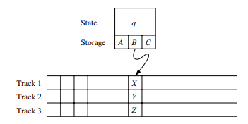
Storage in the State
We can use the finite control not only to represent a position in the program of the Turing machine but to hold a finite amount of data Figure

Slide 64
Mutiple Tracks TM and Subroutine TM
Mutiple Tracks TM:
Another useful trick is to think of the tape of a Turing machine as composed of several tracks. Each track can hold one symbol and the tape alphabet of the TM consists of tuples with one component for each.
Subroutine TM:
As with programs in general it helps to think of Turing machines as built from a collection of interacting components or subroutines A Turing machine subroutine is a set of states that perform some useful process. This set of states includes a start state and another state that temporarily has no moves and that serves as the return state to pass control to whatever other set of states called the subroutine. The call of a subroutine occurs whenever there is a transition to its initial state. Since the TM has no mechanism for remembering a return address that is a state to go to after it finishes, should our design of a TM call for one subroutine to be called from several states we can make copies of the subroutine using a new set of states for each copy. The calls are made to the start states of different copies of the subroutine and each copy returns to a different states.

Slide 65
Extension of Basic Turing Machine (TM)
Multitape TM

Slide 66
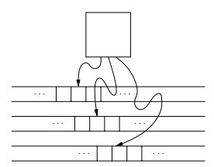
Mutitape TM
A multitape TM is as suggested by Fig below. The device has a finite control state and some finite number of tapes Each tape is divided into cells and each cell can hold any symbol of the finite tape alphabet As in the single tape TM the set of tape symbols includes a blank and has a subset called the input symbols of which the blank is not a member. The set of states includes an initial state and some accepting states Initially
1. The input a finite sequence of input symbols is placed on the first tape
2. All other cells of all the tapes hold the blank
3. The finite control is in the initial state
4. The head of the first tape is at the left end of the input
5. All other tape heads are at some arbitrary cell Since tapes other than the first tape are completely blank it does not matter where the head is
placed initially all cells of these tapes look the same
Multitape TUM

Slide 67
Restricted Turing Machine (TM)
Semi-infinite tape TM
Multi-stack TM

Slide 68
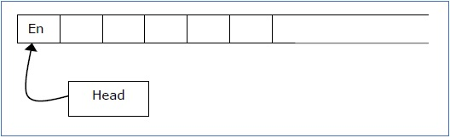


Semi-infinite Tape machine
A Turing Machine with a semi-infinite tape has a left end but no right end. The left end is limited with an end marker.
It is a two-track tape −
Upper track − It represents the cells to the right of the initial head position.
Lower track − It represents the cells to the left of the initial head position in reverse order.
Notes:
The infinite length input string is initially written on the tape in contiguous tape cells.
The machine starts from the initial state q₀ and the head scans from the left end marker ‘End’. In each step, it reads the symbol on the tape under its head. It writes a new symbol on that tape cell and then it moves the head either into left or right one tape cell. A transition function determines the actions to be taken.
It has two special states called accept state and reject state. If at any point of time it enters into the accepted state, the input is accepted and if it enters into the reject state, the input is rejected by the TM. In some cases, it continues to run infinitely without being accepted or rejected for some certain input symbols.
Note − Turing machines with semi-infinite tape are equivalent to standard Turing machines.

Slide 69
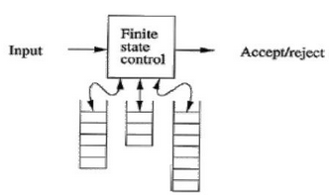
Multi-stack Turing Machine
Generalizations of the PDAs
TMs can accept languages that are not accepted by any PDA with one stack.
But PDA with two stacks can accept any language that a TM can accept.

Slide 70
Multi-stack Turing Machine
A k-stack machine is a deterministic PDA with k stacks.
It obtains its input from an input source rather than having the input placed in a tape.
It has a finite control, which is in one of a finite set of states.
It has a finite stack alphabet, which it uses for all its stacks.
A move of a multistack machine is based on:
The state of the finite control
The input symbol read, which is chosen from the finite input alphabet
The top stack symbol on each stack

Slide 71
Turing Machine and Computers

Slide 72
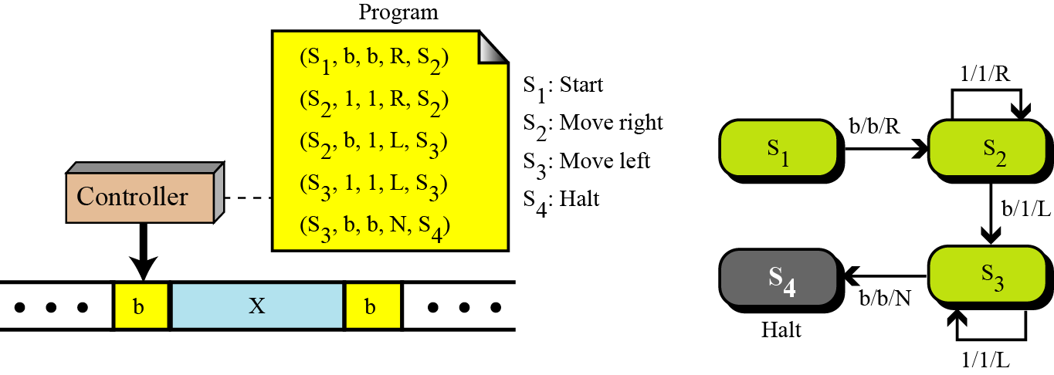
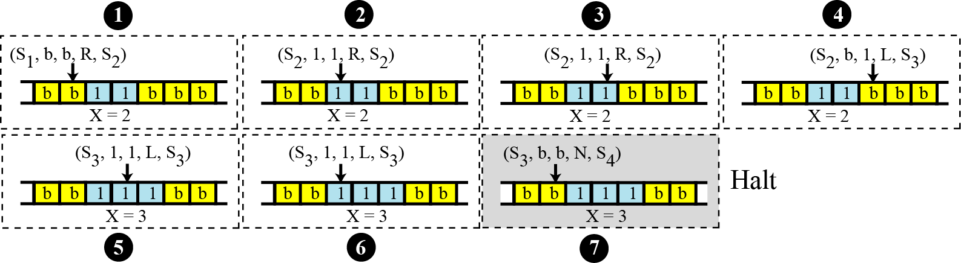
Simulating computer by Turing machine
Example (1): Increment Operation[ incr(x) ]
Step by step operation which shows how the TM can increment x when x=2

Slide 73
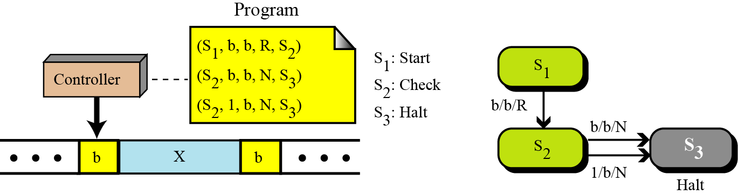
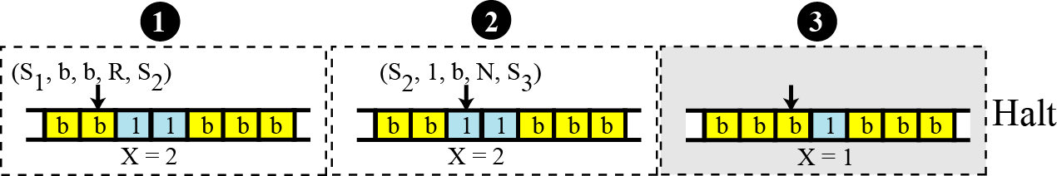
Simulating computer by Turing machine
Example (2): Decrement Operation[ decr(x) ]
Step by step operation which shows how the TM can decrement x when x=2

Slide 74
Introduction to Undecidable Problems
Post Correspondence problem

Slide 75
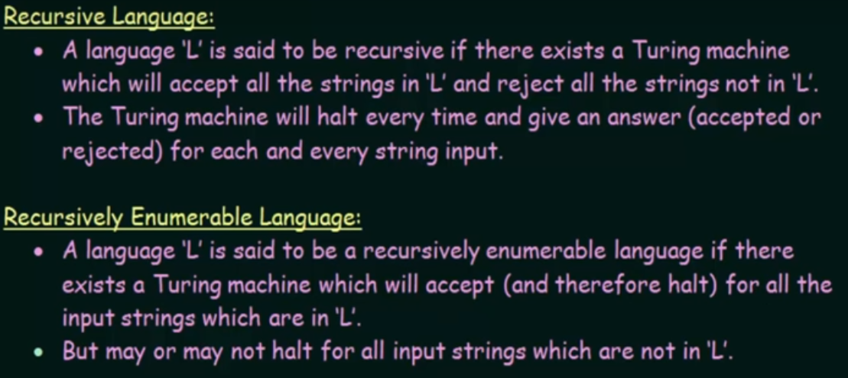
Recursive and Recursively Enumerable language

Slide 76
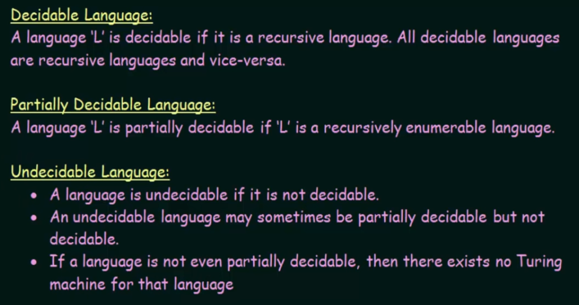
Decidable, Partially-Decidable and Undecidable language

Slide 77
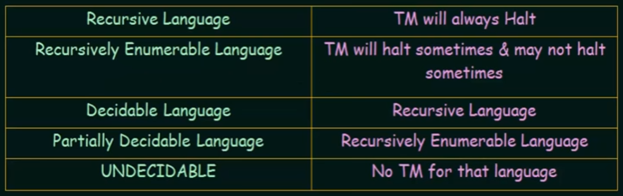
Undecidable Problems

Slide 78
Undecidable problems
Some problems take a very long time to solve, so we use algorithms that give approximate solutions. There are some problems that a computer can never solve, even the world's most powerful computer with infinite time.
An undecidable problem is one that should give a "yes" or "no" answer, but yet no algorithm exists that can answer correctly on all inputs.

Slide 79
Halting Problem
Alan Turing proved the existence of undecidable problems in 1936 by finding an example,
the now famous "halting problem":
Based on its code and an input, will a particular program ever finish running?
For example, consider this program that counts down:
num ← 10
REPEAT UNTIL (num = 0) {
DISPLAY(num)
num ← num – 1
}
That program will halt, since num eventually becomes 0.
Compare that to this program that counts up:
num ← 1
REPEAT UNTIL (num = 0) {
DISPLAY(num)
num ← num + 1
}
It counts up forever, since num will never equal 0.
Algorithms do exist that can correctly predict that the first program halts and the second program never does.
These are simple programs which don't change based on different inputs.
However, no algorithm exists that can analyze any program's code and determine whether it halts or not.

Slide 80
Post Correspondence Problem
The Post Correspondence Problem (PCP), introduced by Emil Post in 1946, is an undecidable decision problem. The PCP problem over an alphabet ∑ is stated as follows −
Given the following two lists, M and N of non-empty strings over ∑ −
M = (x₁, x₂, x₃,………, x_{n})
N = (y₁, y₂, y₃,………, y_{n})
We can say that there is a Post Correspondence Solution, if for some i₁,i₂,………… i_{k}, where 1 ≤ i_{j} ≤ n, the condition x_{i1} …….x_{ik} = y_{i1} …….y_{ik} satisfies.

Slide 81
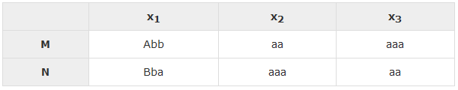
Post Correspondence Problem
Example 1: Find whether the lists
M = (abb, aa, aaa) and
N = (bba, aaa, aa) have a Post Correspondence Solution?
Solution
Here, x₂x₁x₃ = ‘aaabbaaa’ and y₂y₁y₃ = ‘aaabbaaa’
We can see that x₂x₁x₃ = y₂y₁y₃
Hence, the solution is i = 2, j = 1, and k = 3

Slide 82
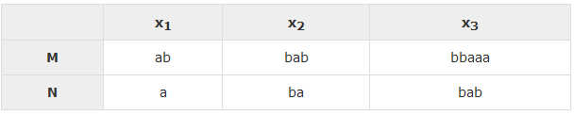
Post Correspondence Problem
Example 2: Find whether the lists M = (ab, bab, bbaaa) and N = (a, ba, bab) have a Post Correspondence Solution ?
Solution:
In this case, there is no solution because −
| x₂x₁x₃ | ≠ | y₂y₁y₃ | (Lengths are not same)

Slide 83
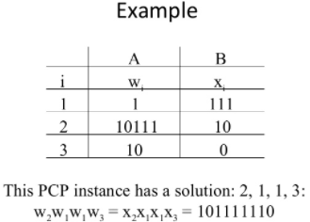
Post Correspondence Problem

Slide 84
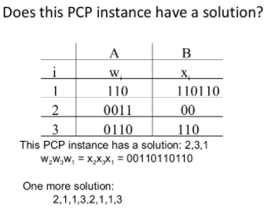
Post Correspondence Problem (PCP)

Slide 85
Thanks for Listening

Slide 86
Program Halting Problem
Input: a program P in some programming language
Output: true if P terminates; false if P runs forever.

Slide 87
Examples
halts(“2+2”)
halts(“def f(n):
if n==0: return 1
else: return n * f(n-1)
f(10)”)
halts(“def f(n):
if n==0: return 1
else: return n * f(n-1)
f(10.5)”)
True
”)
True
False

Slide 88
Tougher Example
halts(“
def isPerfectNumber(n): # n is perfect if factors sum to n
divs = findDivisors(n)
return n == sum(divs)
i = 3
while not isPerfectNumber (i): i = i + 2
print i”)
Unknown
Note: it is unknown where an odd perfect number exists. (Numbers up to 10³⁰⁰ have been tried without finding one yet.)

